Slide 1
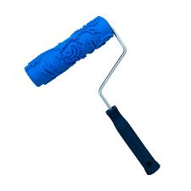
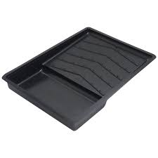
Painting Maintenance
Basic Painting Tools
1. Rollers
- It is used for applying a lot of paint quickly.
2. Paint Tray
-It is used for providing a way to hold a large amount of paint.

Slide 2
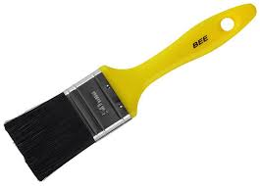
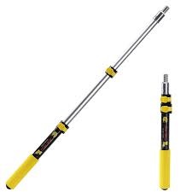
3. Paint Brush
- It is used for cutting in.
4. Extension Pole
- It is used to give you better control .

Slide 3
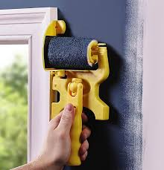
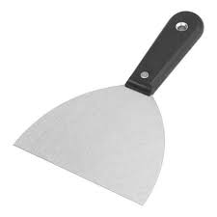
5. Edger
- It is used for wall painting such as above boards etc.
6. Putty Knife
- It is used for scraping away loose paint and putty during a repair.

Slide 4
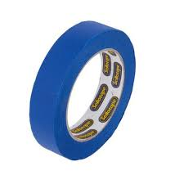
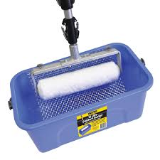
7. Painter’s Tape
- It is used for protecting walls.
8. Paint Bucket
- It is used for carrying a large amount of paint.

Slide 5
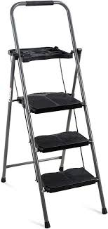
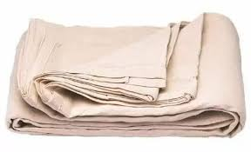
9. Ladder
- It is used for climbing and descending.
10. Drop cloth
- It is used to protect surfaces while painting .
Video : https://youtu.be/kt4CIjdRBlI?si=ERL6oqfvJ9y8XBHp
Feedback : Activity

Slide 6
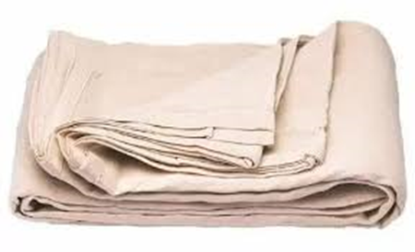



Kwa Thema Skills School
Subject : Maintenance Marks : 10
Grade : Year 1 Time : 30 mins
Date : / / 2024
Question:1
1.Name the following hand tools or equipments that are used in painting.
1.__________________ 2.____________________
3.___________________ 4. ____________________

Slide 7



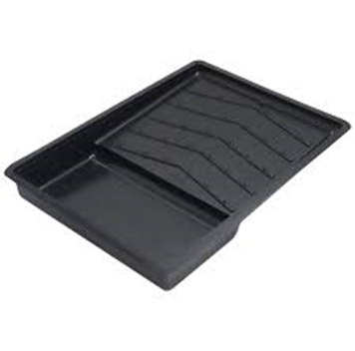
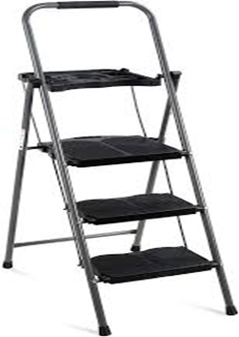

5. _________________ 6. ____________________
7. __________________ 8. ___________________
9. __________________ 10. ___________________
(10)

Slide 8
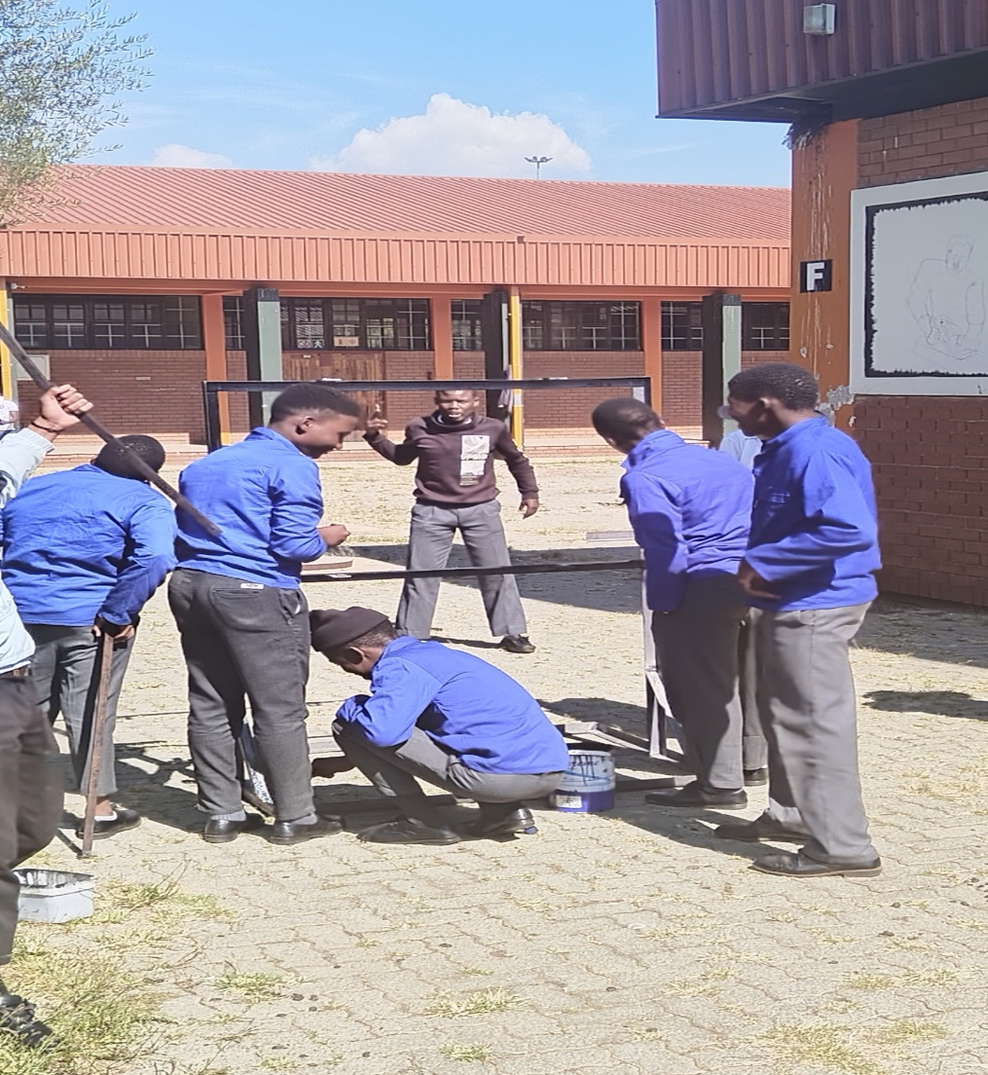
Feedback : Activity
(Practical lesson or Project)
Painting

